Slide 1

Lock System with Facial Recognition and Fingerprint Verification
Final Year Project – BSc (Hons) in Computing
Presented by: Fiachra Mc Eniff

Slide 2
Introduction & Motivation
Traditional access methods (keycards, passwords) are no longer reliable.
Biometric systems offer higher accuracy and are contactless.
COVID-19 emphasized the need for touchless security.
IoT enables real-time monitoring and smarter systems.

Slide 3
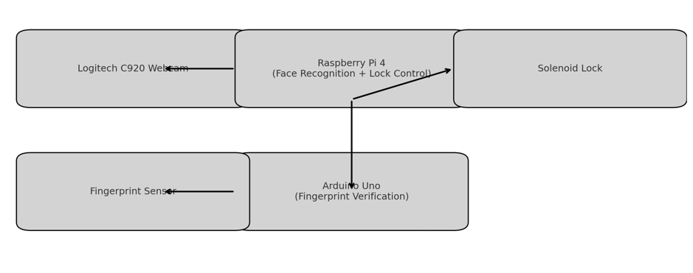
Project Aim & Research Question
Aim: Build a secure locking system using facial and fingerprint verification.
Research Question: Can a locking system be effectively implemented using facial recognition and fingerprint verification to ensure only authorized individuals can access a premises?

Slide 4
System Overview
Raspberry Pi processes facial recognition and controls the lock.
Arduino Uno manages fingerprint scanning and signals Pi.
Solenoid lock activated only after both biometrics succeed.
Uses OpenCV, face_recognition, and GPIO for control.

Slide 5
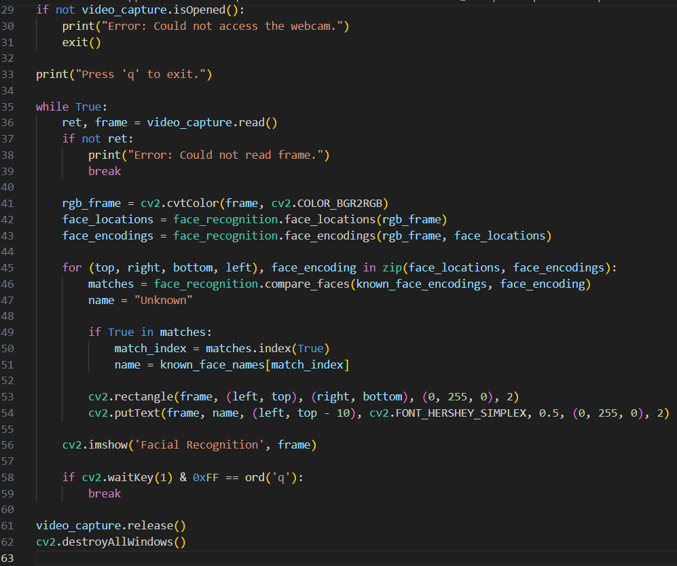
Facial Recognition
Built using OpenCV and face_recognition.
Processes live camera feed using CNN embeddings.
Tested for lighting, angles, and spoofing resistance.
Performs well in under 2 seconds on Raspberry Pi.

Slide 6
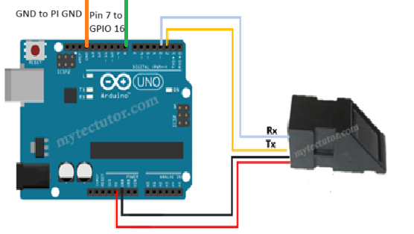
Fingerprint Verification
Optical fingerprint scanner connected to Arduino.
Fingerprint ID is stored, and success triggers GPIO signal to Pi.
Added timeout and error handling for reliability.

Slide 7
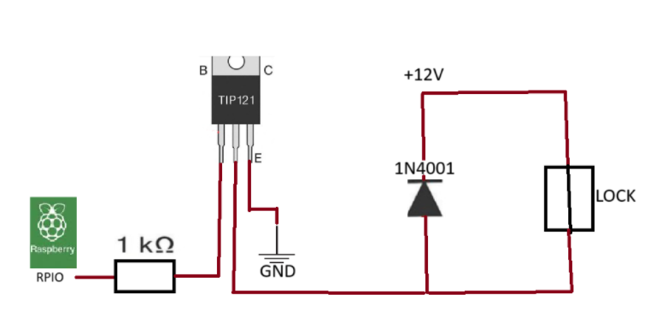
Hardware Implementation
Raspberry Pi 4 with Raspbian OS (SSD-booted for stability).
Logitech C920 webcam for facial input.
TIP121 transistor circuit used to control solenoid.
Safety features: 5-second unlock duration.

Slide 8
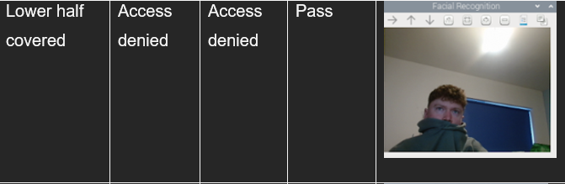
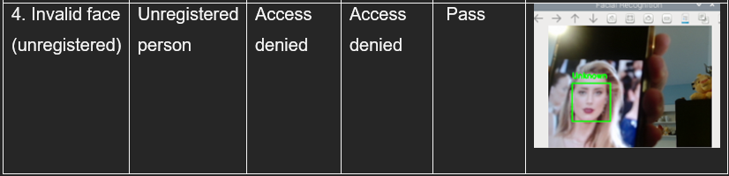
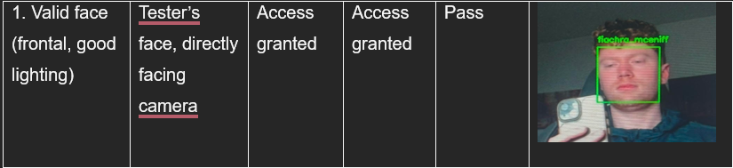
Testing & Results
Facial Recognition: Passed all test cases.
Fingerprint Verification: Worked reliably before hardware failure.
Combined system unlocks in <4 seconds total.

Slide 9
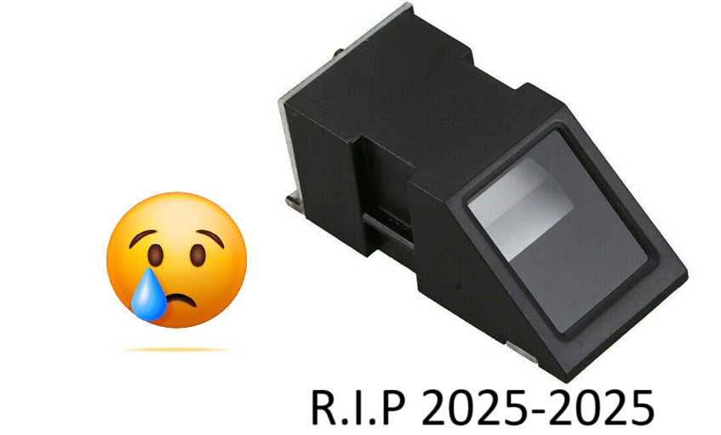
Challenges & Limitations
Hardware Issues: Fingerprint module failed late in project.
Power Stability: Lock heating required unlock time adjustments.
Environmental Sensitivity: Lighting affects face detection.

Slide 10
Conclusion
Conclusion & Reflection
Successfully set up a multi-factor biometric access using facial recognition and fingerprint verification (before the fingerprint module broke near the end) .
Gained valuable experience learning Python, which I wasn’t very comfortable with before this project.
Learned how to set up and work a Raspberry Pi and Arduino.
Built a strong understanding of electronics, circuit wiring, and GPIO communication.

Slide 11

Thanks for listening!

